Slide 1
Object Detection
“Changing the world,
one object at a time…!”

Slide 2
Skills
Subhadip Samanta – Frontend Dev
Wrishav Sett – Backend Dev & ML Models
Sudipta Saha – Connection & Deployment
Subarna Das – Idea Contribution

Slide 3
Contents
Introduction
Popular Object Detection Algorithms
Definition of Problem Statement
Accuracy and Speed
Challenges
Methodology
Software Engineering Model
Demonstration
Q&A

Slide 4
Introduction
Object detection is a field in computer vision that focuses on the development of algorithms and systems capable of identifying and classifying objects in digital images or video. It enables machines to understand and interpret visual information, mirroring human perception.
Object detection originated from early research in computer vision, which began in the 1960s.
Initial approaches were based on simple features and heuristics, but significant progress was made with the advent of deep learning in the 2010s.
Deep neural networks, especially convolutional neural networks (CNNs), revolutionized object recognition by achieving remarkable accuracy and scalability.
The Viola-Jones algorithm, proposed by Viola and Jones in 2001, marked a significant milestone in object detection.

Slide 5
Popular Object Detection Algorithms
Histogram of Oriented Gradients (HOG),
Scale-Invariant Feature Transform (SIFT),
Deformable Part Models (DPM),
Deep Learning-based Approaches such as R-CNN, Fast R-CNN Faster R-CNN,
Single Shot MultiBox Detector (SSD),
You Only Look Once (YOLO),
Two-Stage Detectors such as Mask R-CNN,
EfficientDet and
DETR (DEtection TRansformer).

Slide 6
Definition of Problem Statement
Through this project work we set out to achieve an algorithm that would be able to detect objects not only from still frames but also from live video-feed with enough accuracy to be used in real world scenarios without sacrificing on the speed.
We had several algorithms to work with such as YOLO, SSD and Faster R-CNN.
However amongst the above we decided to move forward using the YOLO algorithm not only because of its high accuracy but also because of its high speed.
Although SSD provides a similarly accurate result through use of predefined anchor boxes, it’s speed is not up to the mark when taking into considerations YOLO algorithms.
Faster R-CNN provides a much more accurate result than both YOLO and SSD algorithms, since it uses a two-stage approach for object detection but it’s not nearly as fast as either in real-world scenarios.

Slide 7
Accuracy and Speed
Algorithm | Precision% | Recall% | F1% | mAP%
YOLOv3 | 69.13 | 80.19 | 70.14 | 80.17
SSD | 63.17 | 88.69 | 72.13 | 82.41
Faster R-CNN | 62.19 | 94.24 | 78.23 | 87.69
Algorithm | mAP% | FPS | Model Size
YOLOv3 | 78.52 | 69 | 236M
SSD | 78.69 | 41 | 445M
Faster R-CNN | 79.63 | 3 | 1129M
*The above data is for the MS COCO dataset comprising of 80 classes

Slide 8
Challenges
While the project development period we faced multiple challenges especially since this was a new field of study for the majority of the individuals of the group. Some of them are:
Learning about Deep Learning and CNN in detail
Knowledge of how to prepare a dataset
Knowledge of the multiple detection algorithms and their advantages and disadvantages and their ease of use for first time developers
Connecting the GUI with the code for deployment which is still under way
Acquiring the necessary files for running the algorithm and use these pretrained files for transfer learning
Resource availability for training models on custom dataset

Slide 9
Methodology
The methodology behind a YOLOv3 algorithm:
Multi-scale detection
Input Image
Feature Extraction
Anchor boxes
Prediction refinement
Non-maximum suppression
Output

Slide 10
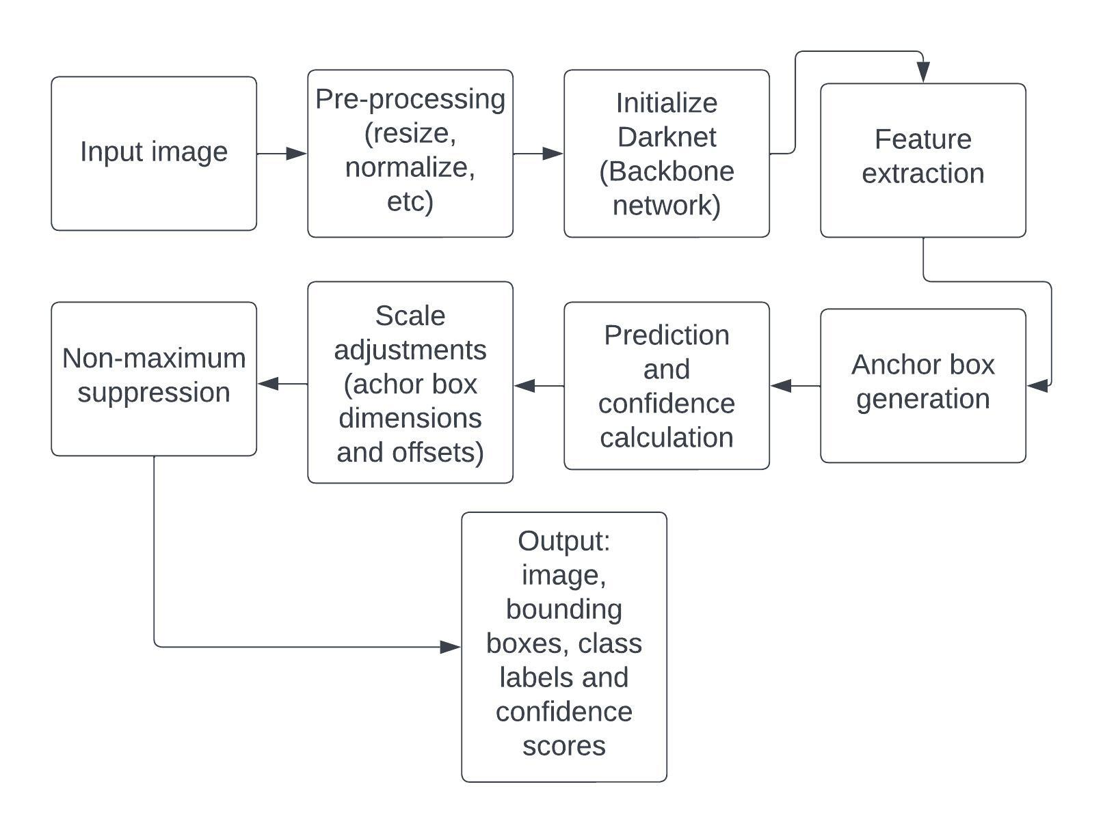
Methodology cont.
Flow chart for the working of YOLOv3 using a pretrained dataset for still images for object detection:

Slide 11
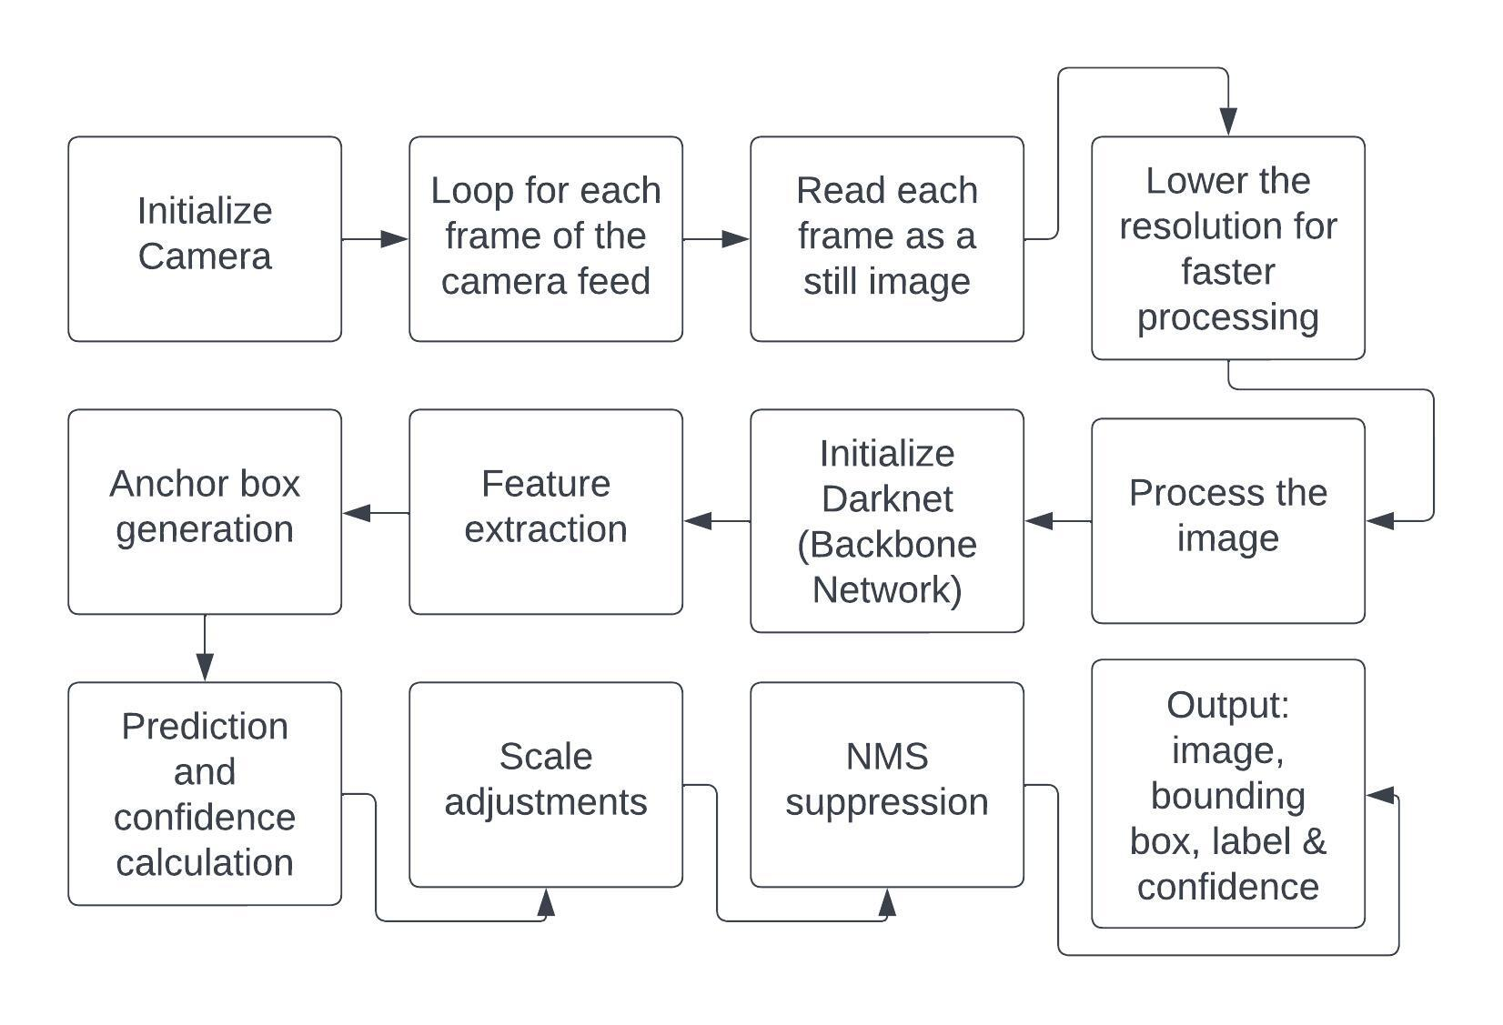
Methodology cont.
Flow chart for the working of YOLOv3 using a pretrained dataset for live video for object detection:

Slide 12
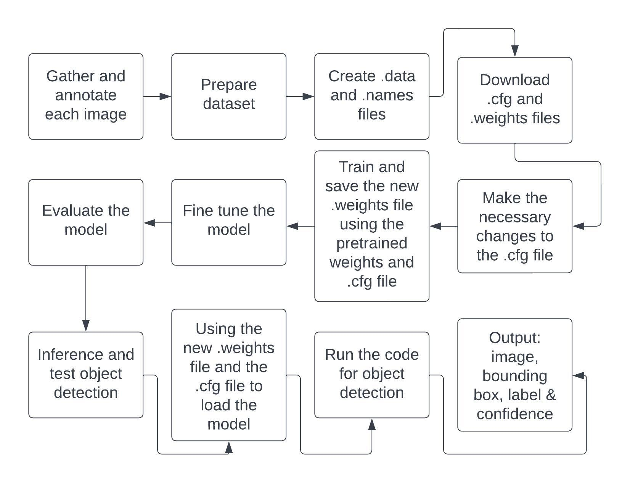
Methodology cont.
Flow chart for the working of YOLOv3 using a custom dataset for still images for object detection:
Once the model is trained to the desired level of accuracy and speed we can proceed to use the model for object detection using the same steps mentioned in slide 8 from still images.
*For further detail refer to page no. 57 to 68, modules 6.9, 6.9.1, 6.9.2 of the project report provided.

Slide 13
Software Engineering Model
A SE Model is a description of the software process that represents one view, such as the activities, data or roles of people involved.
We have used the Incremental Model for our project.
The incremental or iterative and incremental model involves dividing the process into smaller modules and working and delivering said modules as we progress.
Once all the modules are developed they are put together to give the end product or in our case the working project.
The modules that we divided our project into are as follows:
Developing of the GUI
Creating the custom dataset
Training the model for the custom dataset
Using the trained model for object detection
Object detection for still images
Object detection for live video
Connecting the GUI (frontend) and the code (backend) and deployment

Slide 14
Demonstration

Slide 15
Future Scope
Change the backend so that any new image that is detected that was not used in the actual model training would automatically added to the dataset.
Connection of the Real-Time detection code for deployment.
Creating any custom datasets for customer specific needs.
Creating a possible application.

Slide 16
Q&A

Slide 17
The End

